Slide 1

C-Group
Your Data Solutions group

Slide 2
Who we are? -- Welcome the “C- Group
We are “C-Group,” a data analytical staffing team that can support our clients by supplying enhanced data, analysis, and data visualization to ensure our clients successfully meet their business needs. With the rise of data in today’s economy, data-driven our organization is focused on the practical and technical skills needed to analyze and solve complex data problems.
Vendor Selection Process
Currently, we are pleased to be one of three vendors in contention to become your “vendor of choice,” assisting your organization in meeting your data analytical needs.
Recently, C-Group was able to meet with Jason, the lead analyst for the user interface team, and several of his team members. As part of the vendor selection process, we have been asked to prepare and submit a prototype based on certain parameters. Based on our discussion, we were able to outline the initial requirements and create a high-level Business Plan.

Slide 3
What can C-Group do for your Organization?
As part of C-Group’s Data Analytic Services we will:
Export the data, clean it, and use the weather data to choose the best cities for vacation based on certain weather criteria.
Perform statistical calculations on the data and the weather parameters.
Assist the client in collecting and presenting data for customers via the search page, which they will then filter based on their preferred “weather” travel criteria in order to find their ideal city.
Collect and present data for customers via the search page, which they will then filter based on a customer’s preferred “weather” travel criteria in order to find their ideal city.

Slide 4
Initial Requirements
As part of our protype design, C-Group will
Export the data, clean it, and use the weather data to choose the best cities for vacation based on certain weather criteria.
Perform statistical calculations on the data and the weather parameters.
Offer (the client) help to collect and present data for customers via the search page, which they will then filter based on their preferred “weather” travel criteria in order to find their ideal city, anywhere in the world.
Collect and present data for customers via the search page, which they will then filter based on a customer’s preferred “weather” travel criteria in order to find their ideal city.

Slide 5
Outline for Initial Project Plan:
Task: Collect and analyze weather data across cities worldwide.
Purpose: Trafalgar Tours will use the data to recommend ideal travel locations based on clients' air quality and weather preferences.
Method: Create a database containing
The world’s ‘Top 100’ cities and their weather data in real time.
This process will entail collecting, analyzing, and visualizing the data.
Analysis of the data will be split into three main parts or stages.
(Optional Nice to Have): uses of the OpenWeatherMap API to retrieve the JSON weather data from these cities.

Slide 6
Outline for Initial Project Plan:
Task: Collect and analyze weather data across cities worldwide.
Purpose: Trafalgar Tours will use the data to recommend ideal travel locations based on clients' air quality and weather preferences.
Method: Create a database containing
The world’s ‘Top 100’ cities and their weather data in real time.
This process will entail collecting, analyzing, and visualizing the data.
Analysis of the data will be split into three main parts or stages.
(Optional Nice to Have): uses of the OpenWeatherMap API to retrieve the JSON weather data from these cities.

Slide 7
Our Approach:
Our Approach:
Collect the Data
Data Source
Weather data from https://openweathermap.org/api/air-pollution
Tracking to investigate Air Quality in Multiple Cities
Table1: For our Pollution Data: air quality standards as per https://openweathermap.org/api/air-pollution
See Screen Shot for Attributes / Column headers explained.
Gather information to find the Top 100 Cities
Resource: Kaggle
data analysis of air quality in a variety of cities throughout the world.
Our sample database consists of cities chosen at random.
Tom Action Item
Table 2: Top 100 Cities
Table /Database #2: Top Cities Screen Shot
Data Year Collected in 2022 -
Database Source: Kaggle

Slide 8
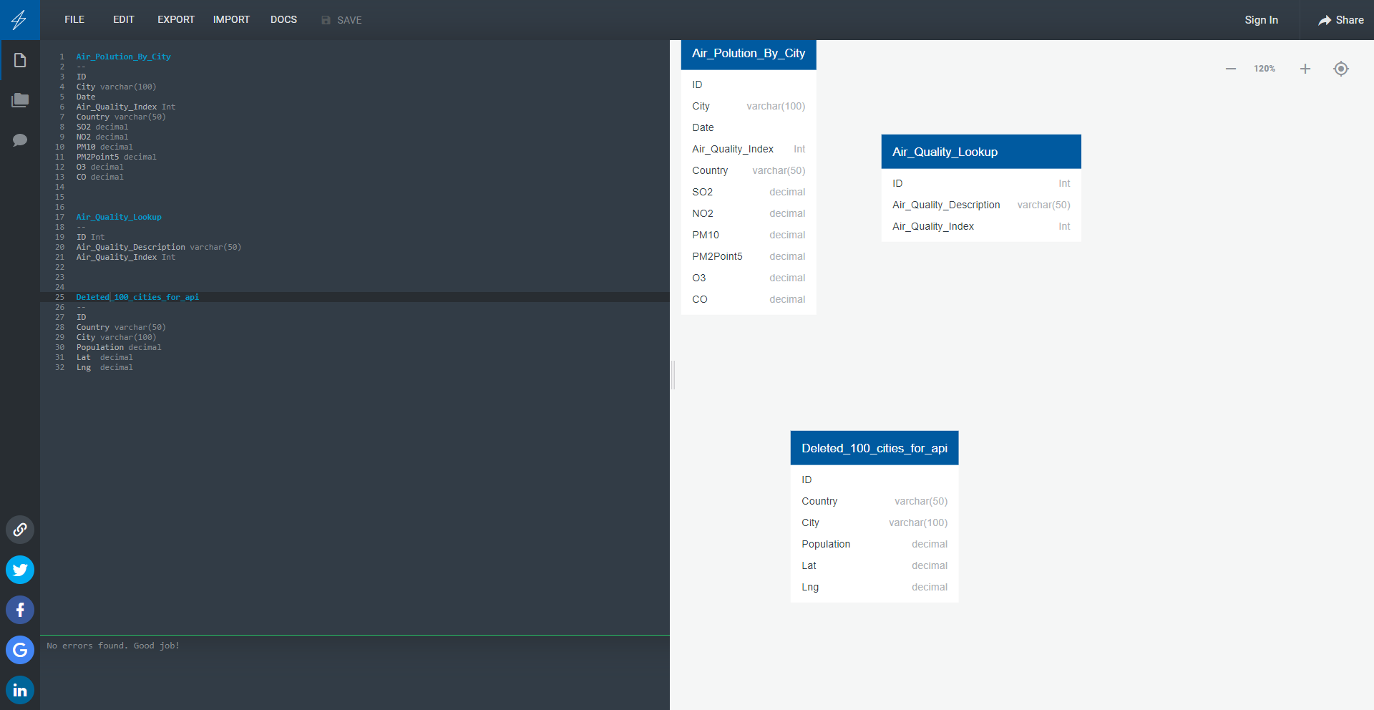
ERM

Slide 9
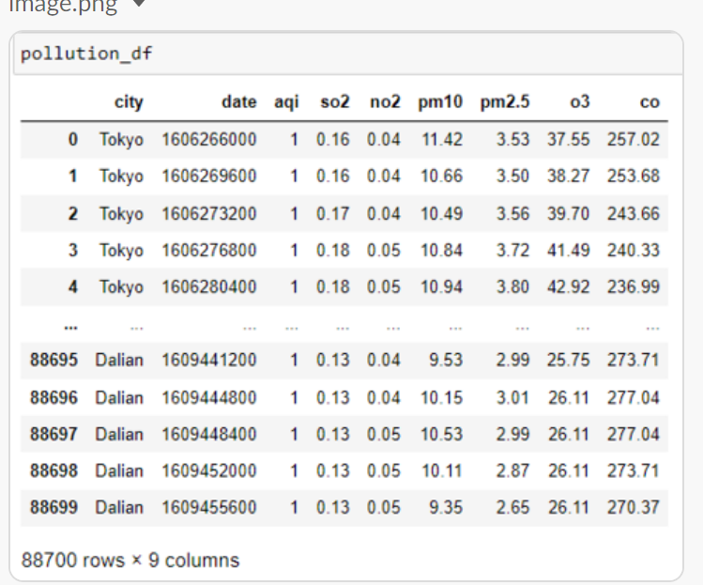
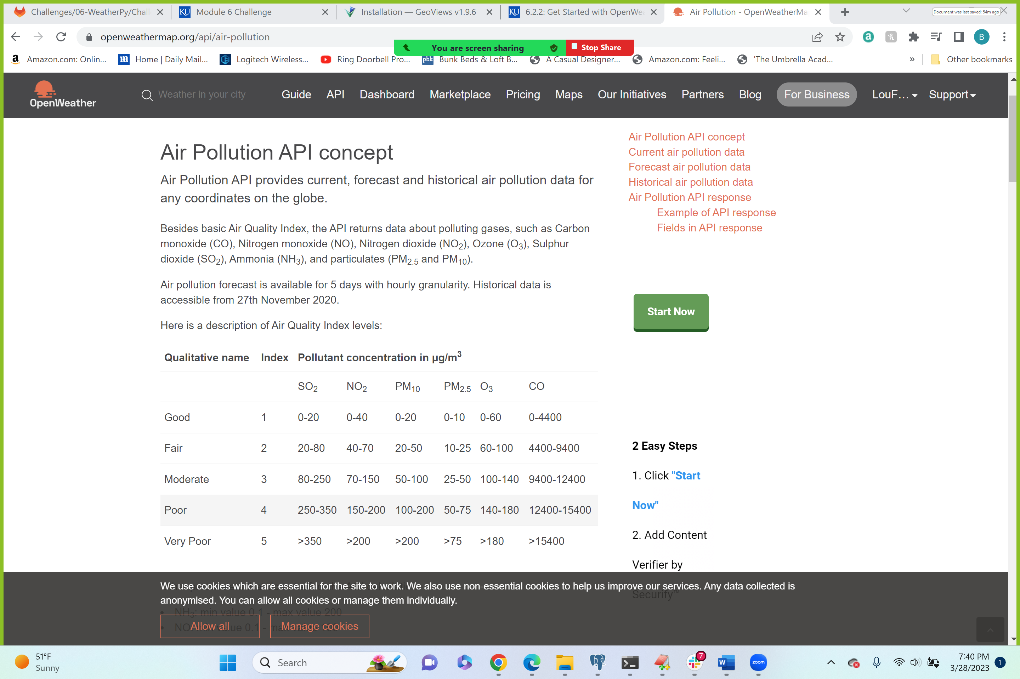
Draft – Air Quality Database

Slide 10
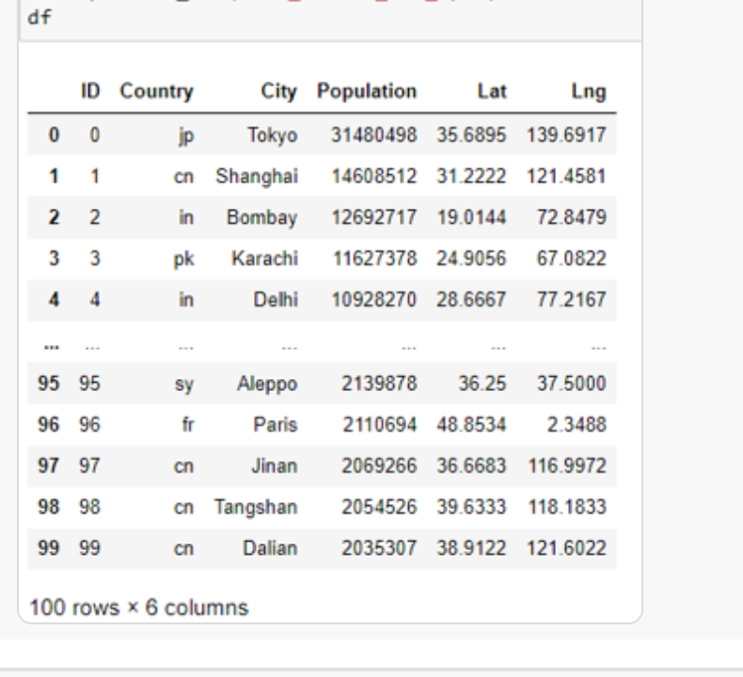
Draft – 100 Top Cities

Slide 11
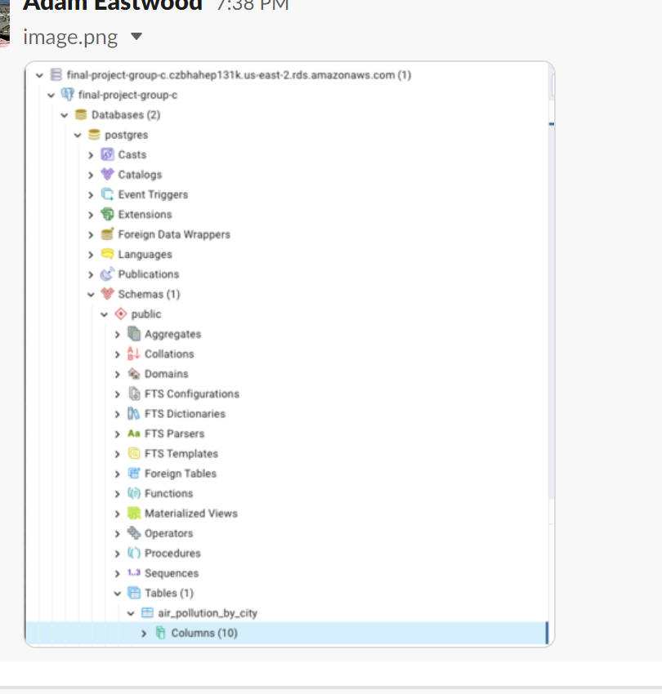
Draft – Database Structure

Slide 12
Exploratory Analysis with Visualization
Tableau
Visualize Travel Data.
Travel agents and customers can utilize the weather data to choose the best cities for vacation based on certain weather criteria,

Slide 13
Visualize Travel Data
Travel agents and customers can utilize the weather data to choose the best cities for vacation based on certain weather criteria,

Slide 14
Machine Learning
Travel agents and customers can utilize the weather data to choose the best cities for vacation based on certain weather criteria,

Slide 15
Observations & Recommendations

